Slide 1
Arrays and records
Programming Language Design and Implementation
(4th Edition)
by T. Pratt and M. Zelkowitz
Prentice Hall, 2001
Section 6.1

Slide 2
Structured Data Objects
Data structure (structured data objects)
  - An aggregate of other data objects (component)
Specification of Data Structure Types
  - Number of components ::: fixed size, variable size
  - Variable size ::: insertion and deletion of components
    Fixed size ::: arrays, records,
    Variable size ::: stacks, lists, sets, tables, files
  - Type of each component
    Homogenous, heterogeneous
  - Names to be used to select components
  - Maximum number of components
  - Organization of the components
    Simple linear sequence of components (vector)
    Multi-dimensional … a vector of vectors (C), a separate type

Slide 3
Operation on Data Structures
Components selection operations
  Random selection, Sequential selection
Whole data structure operations
  SNOBOL, APL, Octave
Insertion and deletion of components
  Storage management and storage representation
Creation and destruction of data structure
  Storage management

Slide 4
Storage Representation and Implementation
Sequential representation
  Base-address-plus-offset
linked list representation
Descriptor (dope vector) of a vector
  Data type
  Lower and upper subscript bounds
  Data type of components
  Size of components
Storage representation for components
  virtual origin ← base address of a vector (array)

Slide 5
Array accessing
An array is an ordered sequence of identical objects.
The ordering is determined by a scalar data object (usually integer or enumeration data). This value is called the subscript or index, and written as A[I] for array A and subscript I.
Multidimensional arrays have more than one subscript. A 2-dimensional array can be modeled as the boxes on a rectangular grid.
The L-value for array element A[I,J]is given by the accessing formula on the next slide

Slide 6
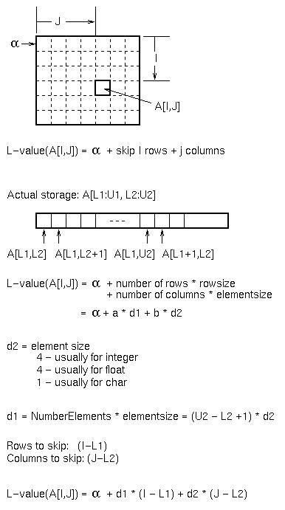

Slide 7

Array accessing (continued)
Rewriting access equation:
L-value(A[I,J]) = α - d1*L1 - d2*L2 +I*d1 + J*d2
Set I = 0; J= 0;
L-value(A[0,0]) = α - d1*L1 - d2*L2 +0*d1 + 0*d2
L-value(A[0,0]) = α - d1*L1 - d2*L2, which is a constant.
Call this constant the virtual origin (VO); It represents the address of the 0th element of the array.
L-value(A[I,J]) = VO +I*d1 + J*d2
To access an array element, typically use a dope vector:

Slide 8
Array accessing summary
To create arrays:
1. Allocate total storage beginning at α:
(U2-L2+1)*(U1-L1+1)*eltsize
2. d2 = eltsize
3. d1 = (U2-L2+1)*d2
4. VO = α - L1*d1 - L2*d2
5. To access A[I,J]: Lvalue(A[I,J]) = VO + I*d1 + J*d2
This works for 1, 2 or more dimensions.
May not require runtime dope vector if all values are known at compile time. (e.g., in Pascal, d1, d2, and VO can be computed by compiler.)
Next slide: Storage representation for 2-dimensional array.

Slide 9
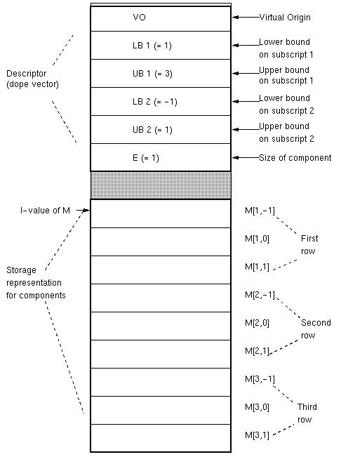

Slide 10
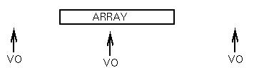
Array example
Given following array: var A: array [7..12, 14..16] of real;
Give dope vector if array stored beginning at location 500.
d2 = 4 (real data)
d1 = (16-14+1) * 4 = 3 * 4 = 12
VO = 500 - 7 * 12 - 14 * 4 = 500 - 84 - 56 = 360
L-value(A[I,J]) = 360 + 12* I + 4* J
1. VO can be a positive or
negative value, and can have
an address that is before,
within, or after the actual
storage for the array:
2. In C, VO = α since bounds start at 0.
Example: char A[25]
L-value(A[I]) = VO + (I-L1) * d1 = α + I * 1 = α + I

Slide 11
Indexing Methods
Column Major
  FORTRAN
  GNU Octave, MATLAB, R
Low major
  C, Pascal, …

Slide 12
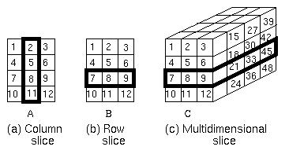
Slices

Slide 13
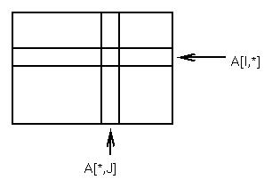
Array slices
Given array : A[L1:U1, L2:U2]: Give d1, d2, and VO for vector:
Dope vector A[I,*] = B[L2:U2]
VO = L-value(A[I,L2]) - d2*L2
M1 = eltsize = d2
Dope vector A[*,J] = B[L1:U1]
VO = L-value(A[L1,J]) - d1*L1
M1 = rowsize = d1
Create new dope vector that accesses original data

Slide 14
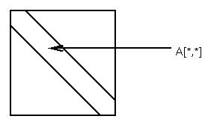
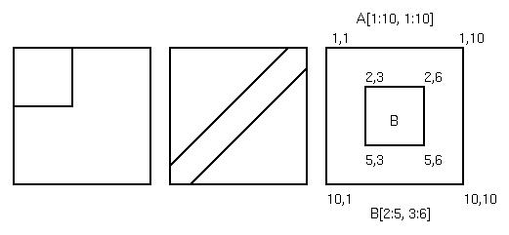
More on slices
Diagonal slices:
VO = L-value(A[L1,L2])
- d1*L1 - d2*L2
M1 = d1 + d2
Other possibilities:

Slide 15
Associative arrays
Access information by name without having a predefined ordering or enumeration:
Example: Names and grades for students in a class:
NAME[I] = name of Ith student
GRADE[I] = Grade for Ith student
Associative array: Use Name as index:
CLASS[name] will be grade.
Problem: Do not know enumeration before obtaining data so dope vector method of accessing will not work.
Implemented in Perl and in SNOBOL4 (as a table)

Slide 16
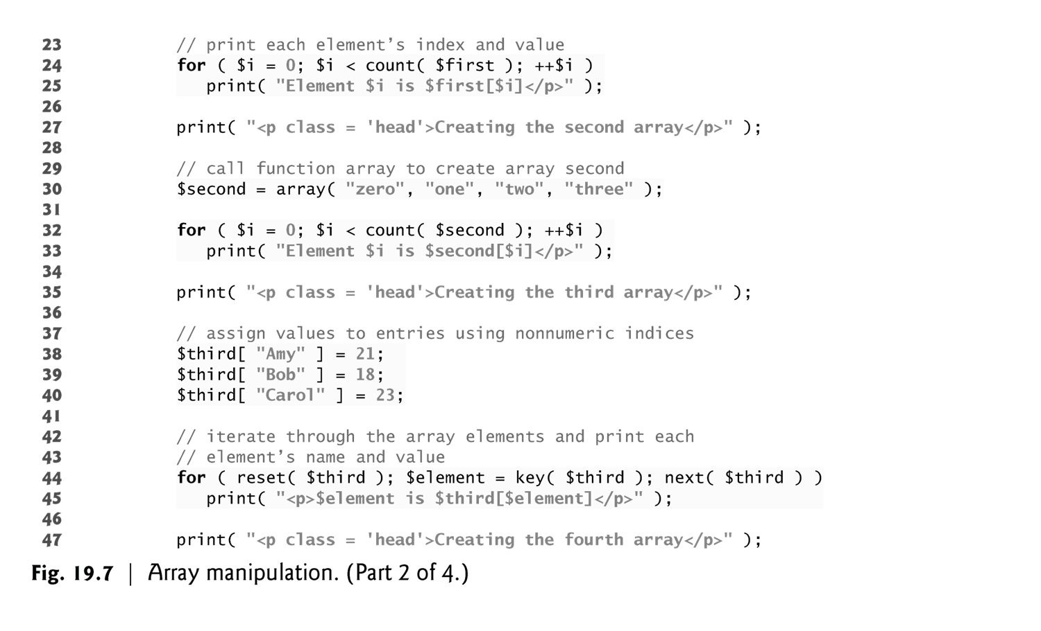

Slide 17
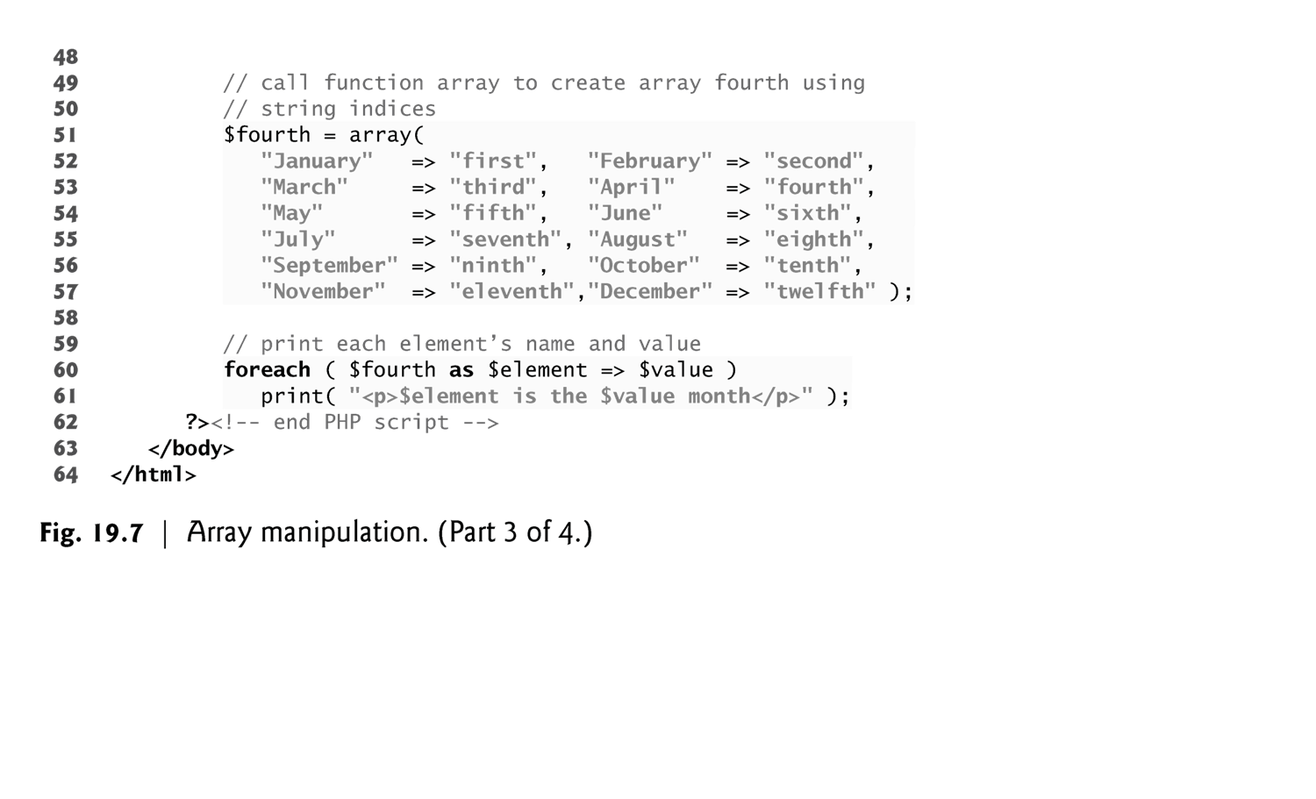

Slide 18
Perl example
%ClassList = (“Michelle”, `A', “Doris”, `B', “Michael”, `D'); # % operator makes an associative array
$ClassList{‘Michelle’} has the value ‘A’
@y = %ClassList # Converts ClassList to an enumeration
# array with index 0..5
$I= 0 $y[$I] = Doris
$I= 1 $y[$I] = B
$I= 2 $y[$I] = Michael
$I= 3 $y[$I] = D
$I= 4 $y[$I] = Michelle
$I= 5 $y[$I] = A

Slide 19
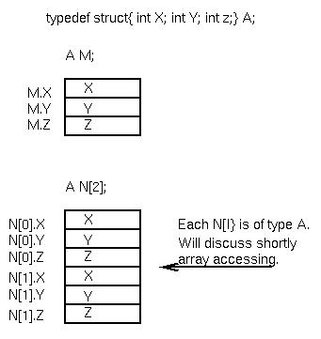
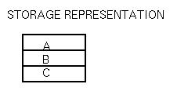
Structs in C
Representation: a
sequence of objects:
record { A: object;
B: object;
C: object }

Slide 20

Union types
typedef union { int X;
float Y;
char Z[4];} B;
B P;
Similar to records, except all have overlapping (same) L-value.
But problems can occur. What happens below?
P.X = 142;
printf(“%O\n”, P.Z[3])
All 3 data objects have same L-value and occupy same storage. No enforcement of type checking.
⇒ Poor language design

Slide 21
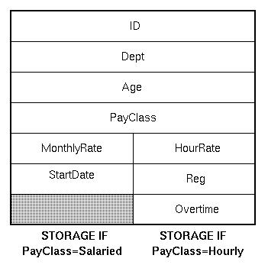
Variant records
type PayType=(Salaried, Hourly);
var Employee:record
ID: integer;
Dept: array[1..3] of char;
Age: integer;
case PayClass: PayType of
Salaried:(MonthlyRate:real;
StartDate:integer);
Hourly:(HourRate:real;
Reg:integer;
Overtime:integer)
end

Slide 22

Variant records (continued)
Tagged union type - Pascal variant records
type whichtype = (inttype, realtype, chartype);
type uniontype = record
case V: whichtype of
inttype: (X: integer);
realtype: (Y: real);
chartype: (Z: char4); Assumes string of length 4
end
But can still subvert tagging:
var P: uniontype
P.V = inttype;
P.X = 142;
P.V = chartype;
What is P.V value now?

Slide 23
Lists, Sets
Not fixed, not homogenous
Lisp의 자료구조 설명
car, cdr, cons
Stacks, queues, trees, directed graphs, property list
Property lists (table, description list)
  Property name (attribute) – property value (value)
Sets
  Elements: membership, insertion. deletion
  Sets: union. intersection, difference
  Implementation :::
    Hashing ← elements에 대한 operations은 쉬우나, set 간의 연산은 어려움

Slide 25
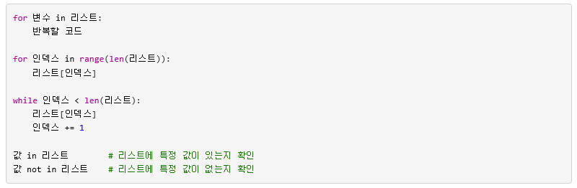
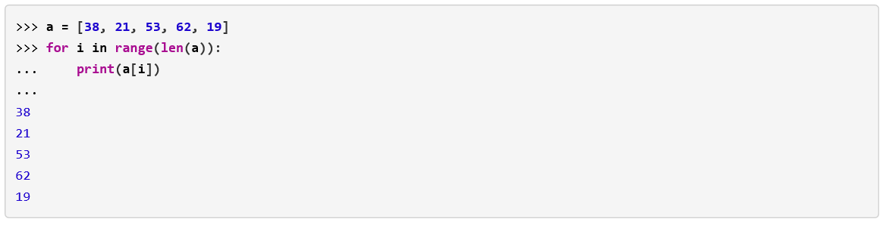
리스트와 반복문

Slide 26
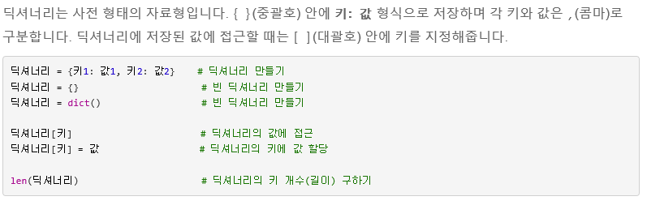
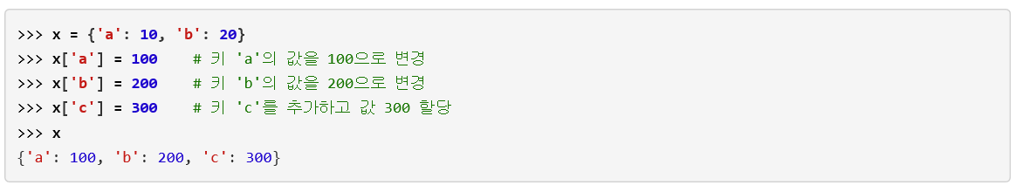
Property List (Dictionary in Python)

Slide 27
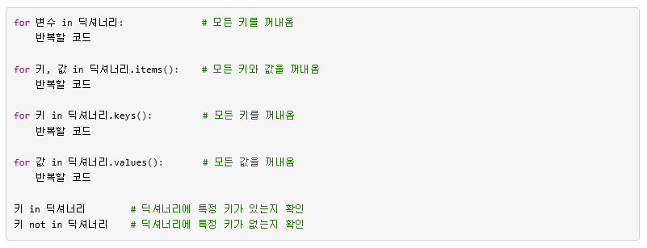
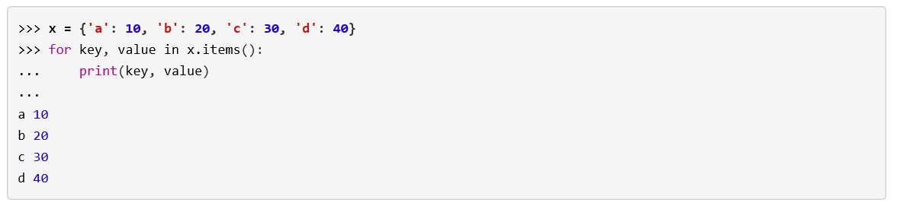
Property List (Dictionary in Python)

